Slide 1


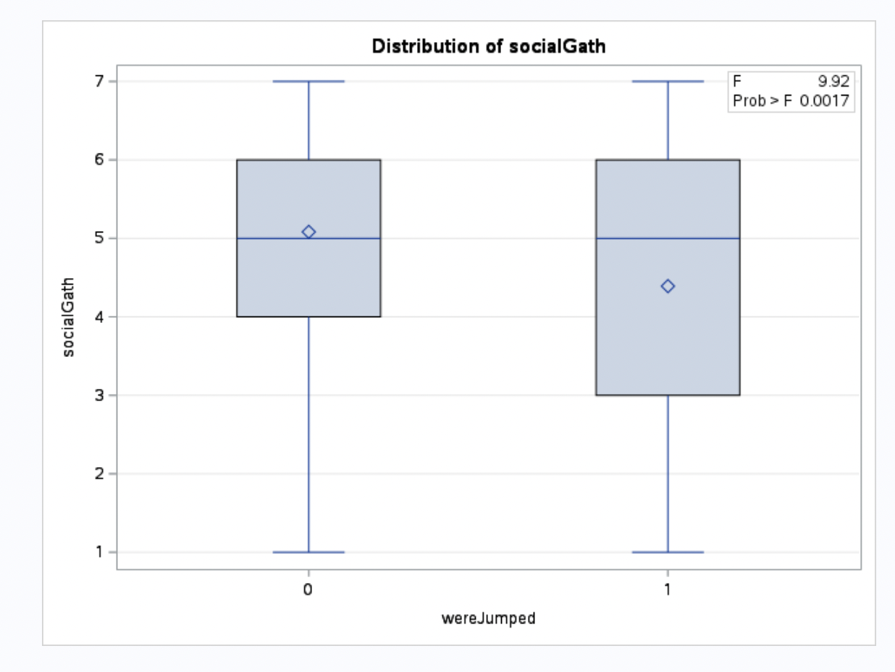
Violence and Its Long-term Impact on Adult Social Outcomes
Herman Bikoko, Quantitative Analysis Center, Wesleyan University
Introduction
Methods
Violence as a developmental influence: Violence in early life is a significant factor potentially influencing a range of adult outcomes. Past research predominantly focuses on immediate or short-term effects, such as trauma or behavioral issues during childhood and adolescence.
Gaps in current understanding: While the immediate impacts of violence are well-documented, less is known about how early exposure to violence influences long-term social integration and participation in adulthood. This gap highlights the need for a deeper exploration of violence's prolonged effects.
Exploring new dimensions: Recent studies suggest that experiences of violence could shape adult behaviors in complex ways, possibly affecting social engagement, marital status, and community involvement. However, most research has not distinguished the impacts of being a perpetrator from that on a victim.
Hypothesis and potential mechanisms: This study hypothesizes that exposure to violence in early life may correlate with decreased social participation in adulthood.(Lilly, M. M., Roberts, Y. H., & Beitel, M., 2015).
Sample
Population: The study analyzed data from adults who reported experiences of violence during childhood or adolescence. This included both perpetrators and victims of violence.
Source: Data were drawn from a longitudinal study tracking individuals from early childhood into adulthood, ensuring a comprehensive view of their development and societal interactions.
Data Collection
Survey Instruments: Participants were assessed through various standardized tools that measure exposure to violence, mental health status, and social outcomes.
Variables Measured: Key variables included frequency of violent incidents, types of violence (perpetrated and experienced), social participation in adulthood (measured through social gatherings, community involvement), and marital status.
Statistical Methods
Analysis Tools: Data were managed and analyzed using SAS software, employing techniques such as logistic regression, ANOVA, and frequency distribution analysis to explore the relationships between early violence exposure and adult outcomes.
Handling Missing Data: Procedures were implemented to address and mitigate the impact of missing data on the study's findings
Research Question(s)
Is violence, whether perpetrated or experienced, related to outcomes in adulthood?
Results
Discussion
Univariate Analysis
Prevalence of Violence Exposure: A significant portion of the study's participants reported exposure to violence during childhood. The analysis shows that 65% of participants experienced or perpetrated violence before the age of 18.
Social Outcomes in Adulthood: Nearly 60% of these individuals reported difficulties in social integration and lower participation in social gatherings as adults.
Bivariate Analysis
Violence and Social Participation: Participants with a history of violence exposure were more likely to report lower social participation in adulthood compared to those without such a history. The difference in social participation rates was statistically significant (χ²=15.2, p<.01), although not practically so.
Marital Status: Exposure to violence was also associated with a lower likelihood of being married or in a stable relationship, with 50% of exposed individuals reporting they were unmarried, compared to 40% of those not exposed (χ²=9.8, p<.05).
Multivariate Analysis
Adjusting for Confounding Factors: After adjusting for demographic variables and early life socioeconomic status, the association between violence exposure and social participation remained statistically significant.
Interaction Effects: The interaction between the type of violence (perpetrated vs. experienced) and social outcomes was analyzed. The data suggest that individuals who experienced violence are slightly more likely to suffer from social disengagement than those who perpetrated violence, although a stronger gap was not seen.
Sensitivity to Social Outcomes: Individuals who experienced or perpetrated violence during their formative years show different levels of social participation in adulthood. Similar to how individuals with major depression or specific phobias may have heightened sensitivity to nicotine dependence, those exposed to violence may be particularly vulnerable to social disengagement.
Modulating Factors: Just as individuals with alcohol dependence may respond differently to nicotine depending on the levels of consumption, the impact of violence on social outcomes appears to vary. Those with repeated or severe exposure to violence often report greater challenges in social settings compared to those with less severe experiences.
Data Interpretation and Limitations: Notably, our findings are based on cross-sectional data, which limits our ability to infer causation or track how social outcomes evolve over time following early exposure to violence. The study does not account for all possible confounding factors such as socioeconomic status or subsequent life events that could influence adult behavior.
Need for Further Research: Further research is needed to determine whether the observed differences in social participation are primarily driven by psychological changes associated with early violence exposure or if other factors, such as changes in social environment or ongoing stress, play more significant roles. Additionally, a more comprehensive look that assess confounding and moderating variables. For example, a moderating variable could be religiosity.
Figure 1. Social Participation by Violence Exposure
Figure 2: Marital Status by Violence Exposure
(Lilly, M. M., Roberts, Y. H., & Beitel, M., 2015).
Adjei, S. B., & Mpiani, A. (2022)
Gonçalves, M., & Gonçalves de Bernardin, J. P. (2020)
Band-Winterstein, T., & Freund, A. (2018)
Rasool, S., & Suleman, M. (2016)

Slide 2
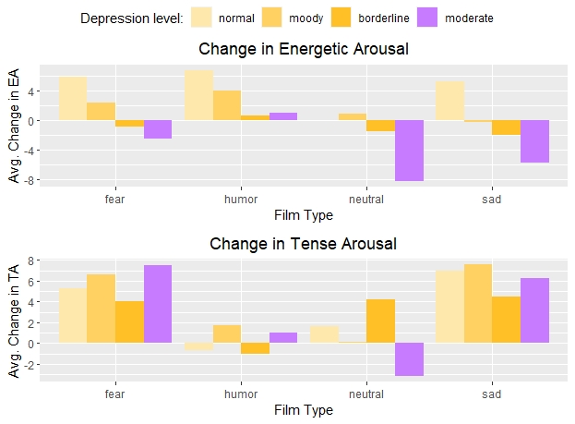
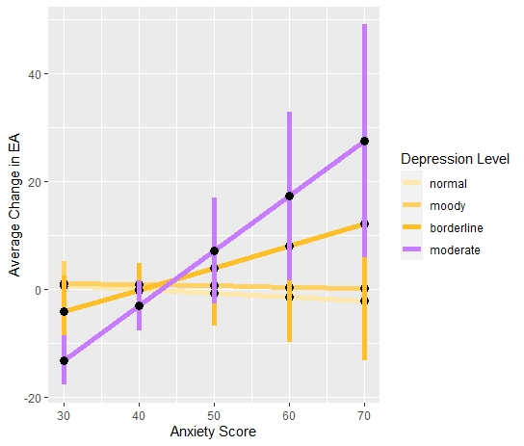
The relationship between depression and Psychophysical states induced via film
Student Name, Quantitative Analysis Center, Wesleyan University
Introduction
Methods
Prevalence of Depression: In the United States, over the last 12-15 years, there has been a general increase in major depression across all age groups. (Weinberger et al., 2015; Substance Abuse and Mental Health Services Administration [SAMHSA], 2020).
Positive & Negative Affect (PANAS): A psychological model containing two “emotional” dimensions: Positive Affect and Negative Affect (PA & NA). Each respectively represents “positive” and “negative” emotional states. (Watson & Tellegen, 1985; Watson et. al 2002; Koval et al., 2013; Gruber et. al., 2011; Fernández-Aguilar et al., 2019).
Current Findings: Film clips are a proven mood induction procedure (MIP) used to induce changes in affect. (Fernández-Aguilar et al., 2019). Compared to non-depressed individuals, when watching films, depressed individuals tend to experience:
  Anhedonia or decreased PA (Watson & Tellegen, 1985; Watson et. al 2002; Fernández-Aguilar et al., 2019)
  A decrease in the induction of pride among other aspects of PA. (Gruber et. al., 2011)
Activation Deactivation Check List (ADACL): A psychological model containing two physiognomic states: Energetic and Tense Arousal (EA & TA). Each dimension respectively represents “Energetic” & “Tense” psychophysical profiles. (Thayer, 1989)
Gap in Literature: The DSM-IV characterizes fatigue as a major symptom of depression. (American Psychiatric Association, 2013). However, fatigue or general lack of energy falls under the Activation-Deactivation Check List (ADACL). While some Film based MIP’s have included this variable, few studies have specifically been conducted considering the ADACL in relation to depression.
Sample
College students who attended an introductory psychology course (n=160) were drawn from a study conducted at the Personality, Motivation and Cognition (PMC) Laboratory at Northwestern University.
Measures
Participants were shown four films which are listed according to the main emotion elicited: “Fear”, “Humor”, “Neutral”, and “Sadness.”
Major Depression was assessed using the Beck’s Depression Inventory (BDI) a self-assessment questionnaire where each question has a score. Higher scores indicate higher levels of depression.
  Scores were categorized into the four levels: “Non-Depressed”, “Moody”, “Borderline” and “Moderate Major Depression.”
PANAS, and ADACL were recorded using the Mean States Questionnaire (MSQ) a self-assessment questionnaire where each question has a score based on items from the PANAS and ADACL scales. Below are said items
  PA: active, excited, strong, inspired, determined, attentive, interested, enthusiastic, proud, alert
  NA: jittery, nervous, scared, afraid, guilty, ashamed, distressed, upset, hostile, irritable
  EA: active, excited, strong, inspired, determined, attentive, interested, enthusiastic, proud, alert
  TA: Intense, Jittery, fearful, tense, clutched up, -quiet, -still, - placid, - calm, -at rest
Research Questions
Are results from previous studies investigating the association between PANAS and depression replicable?
Given said replicability, what is the a association, if any at all, between the ADACL and Depression as induced via film?
Results
Discussion
Univariate
A total of 10.6% of the sample recorded scores corroborating “moderate major depressive disorder.” The rest recorded sub-clinical scores.
The significantly decreased Positive Affect and lack of significant difference in Negative Affect corroborate previous findings in the literature (Anhedonia and Lack of Induced Negative Affect).
The significant decreases in EA provide evidence for a statistically discernable relationship between depression and the ADACL scales when using an MIP.
The data shows decreased PA and EA, and increased NA as depression scores increase, even among participants with non-diagnosable BDI scores. However these groups show non-significant difference from the “normal group.
Small sample size limits the legitimacy of the results
Further studies must consider/include the following:
  Larger Sample Size
  Focus on specific psycho-emotional profiles in relation to the ADACL. (i.e. do sad films increase tiredness?)
  The comorbidity of Anxiety and Depression
Bivariate
Analysis of variance (ANOVA) indicated a significant decrease in positive affect for depressed participants as compared with their non-depressed counterparts. These results were constant across all films with the exception of the “fear” film.
ANOVA also indicated weak to no significant difference in induced negative affect between depressed and non-depressed groups across all films.
Furthermore, ANOVA revealed that clinically diagnosable individuals recorded significantly decreased energetic arousal in the neutral and sad films compared to those with non-clinically diagnosable scores.
Conversely, ANOVA showed weak to no significant difference between depression and change in tense arousal across all films.
Figure 1. Change in PANAS Scales by Film Type.
Film Type |  | Change in PA | Change in NA | Change in EA |  | Change in TA
Fear
Humor |  | Mean= -3.00 s.d=±6.20 F(3, 34)=3.859 p=0.018.
Neutral |  | Mean= -9.00 s.d.=±9.90 F(3, 39)=6.306 p=0.0014 |  | Mean= -8.33 s.d.=±8.16 F(3, 39)=5.528 p=0.0029. |  | Mean= -3.167 s.d= ±6.20 F(3, 39)=2.904 p=0.047.
Sad |  | Mean= -7.50 s.d.=±3.86 F(3, 38)=8.192 p=0.0035 |  | Mean= -5.75 s.d.= ±5.56 F(3, 38)=6.568 p=0.0011.
 | SIGNIFICANT (p<0.05) |  | NOT SIGNIFICANT (p>0.05) |  | WEAKLY SIGNIFICANT (p<0.05 but no significant post-hoc results)
Figure 2. ANOVA results for change in PANAS and ADACL for depressed vs Non Depressed per Film Type
Multivariate
The interaction between Major Depression and Anxiety was found to be significantly associated with change in EA (Beta = 1.02, CI(0.431, 1.74), p = 0.0019). Participants with higher trait anxiety and BDI scores tended to experience increased EA when watching the neutral film.
Fernández-Aguilar, L., Navarro-Bravo, B., Ricarte, J., Ros, L., & Latorre, J. M. (2019). How effective are films in inducing positive and negative emotional states? A meta-analysis. PLoS ONE, 14(11), e0225040. https://doi.org/10.1371/journal.pone.0225040
Rafaeli, E., & Revelle, W. (2006). A premature consensus: Are happiness and sadness truly opposite affects? Motivation and Emotion. Motiv Emot 30, 30(1), 1–12. https://doi.org/10.1007/s11031-006-9004-2
Thayer, R. E. (1989). The Biopsychology of Mood and Arousal. Oxford University Press USA.
Watson, D., & Tellegen, A. (1985). Toward a consensual structure of mood. Psychological Bulletin, 98(2), 219–235. https://doi.org/10.1037//0033-2909.98.2.219
Figure 3. Regression of Average Change in EA on BDI Categories

Slide 3


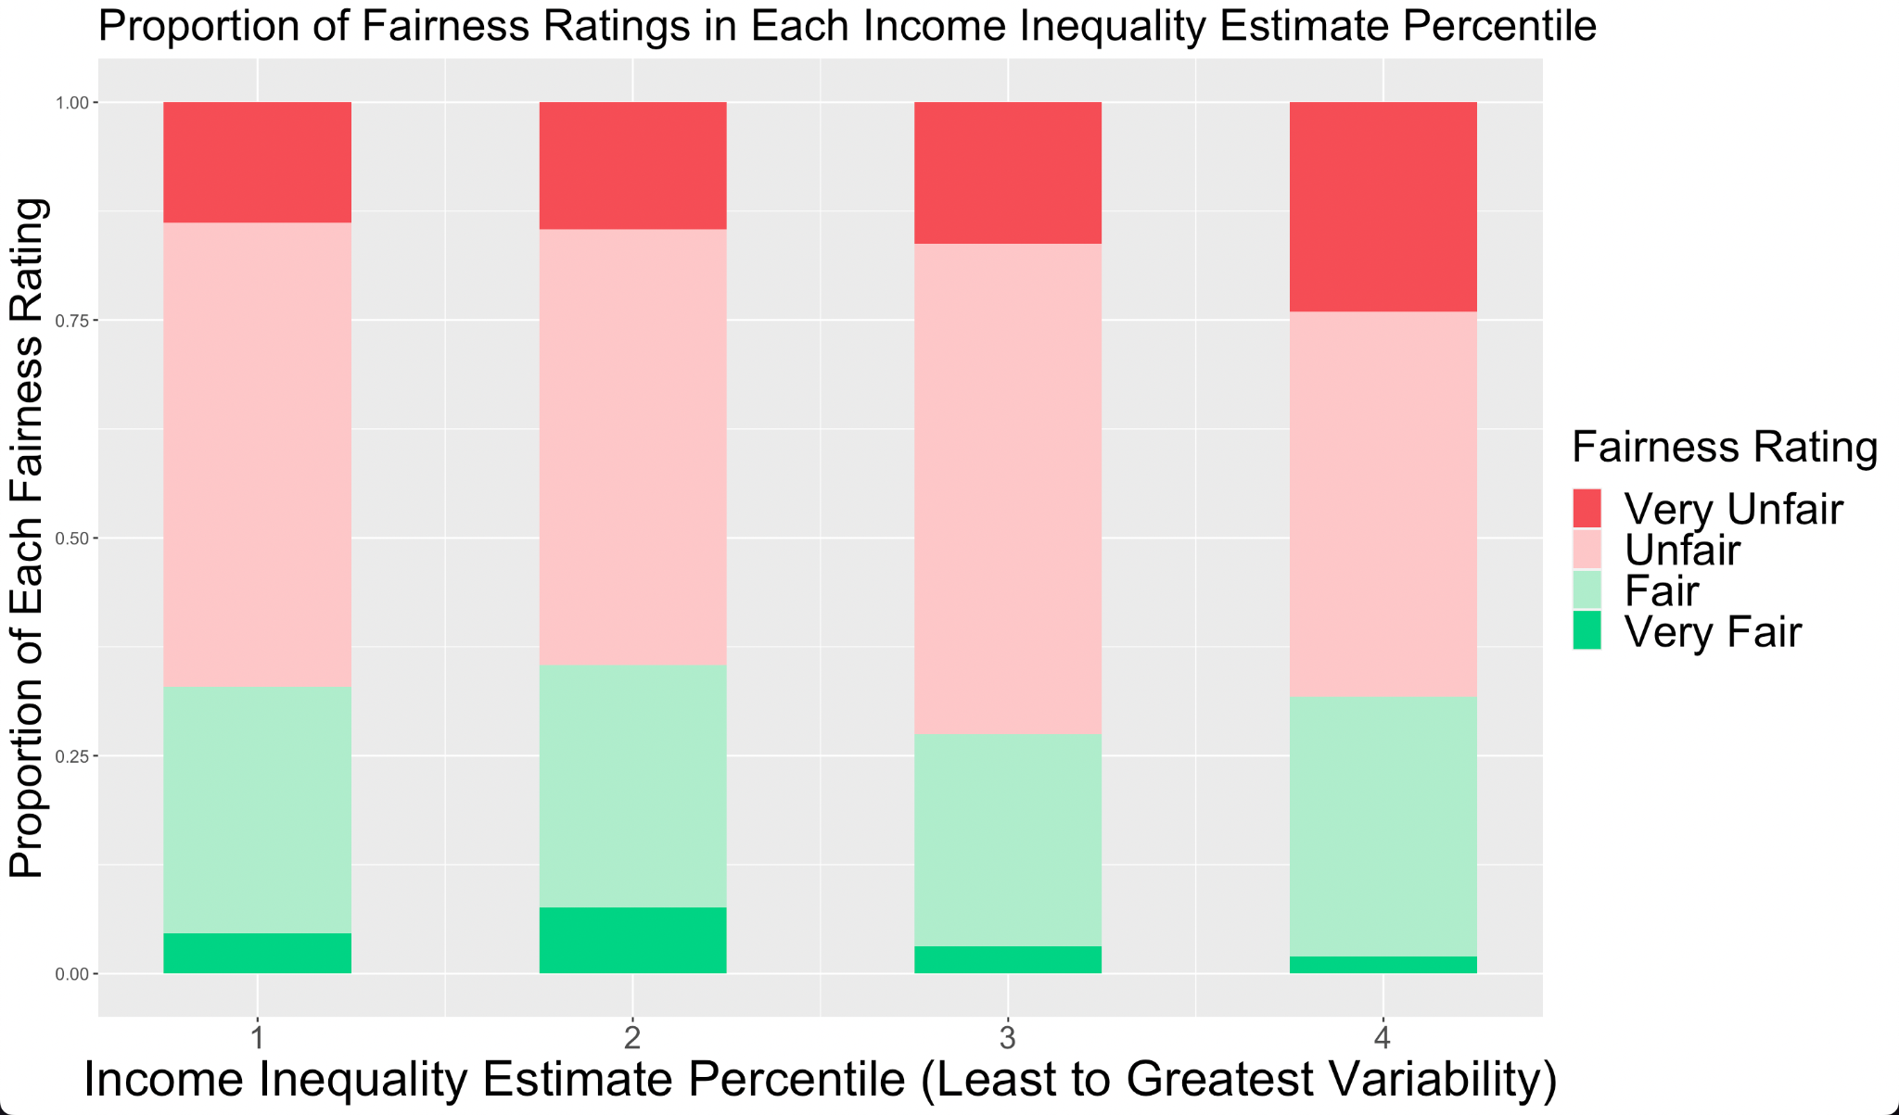
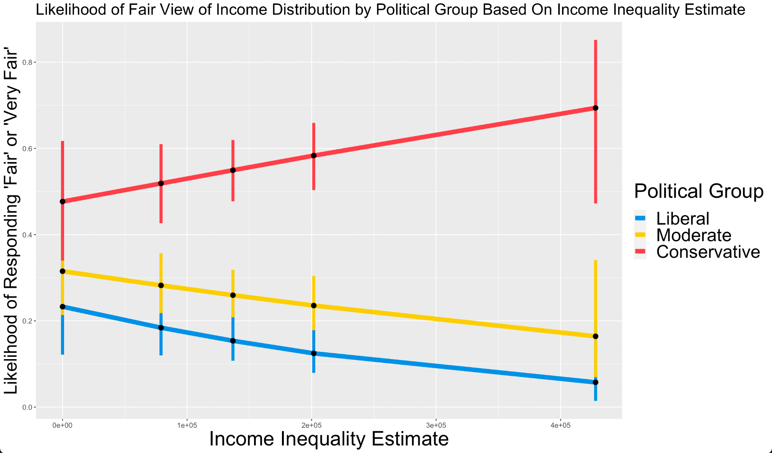
The Relationship Between Perception of Income Inequality and Opinion
of Income Distribution in the U.S.
Name, Applied Data Analysis, Wesleyan University
Introduction
Research Questions
Perception of income inequality is more strongly associated with opinions than reality, but there is disagreement on how they are related (Fatke 2018, Kuhn 2020, Trump 2017).
The relationship between perception and opinion varies between nations; for example, Chinese and Latin American residents’ patterns differ (Reyes 2022, Wei 2022).
Political affiliation is also associated with one’s perception of and opinion on economic inequality, with left-wing individuals more likely to perceive inequality as high and unfair (Chambers 2014, Reyes 2022).
Are Americans who perceive income inequality to be high more likely to believe that income distribution is unfair than those those who perceive income inequality to be low?
Does this relationship differ between those with different political beliefs?
Methods
Sample
Respondents (n=624) were drawn from the General Social Survey (GSS) of 2021, a nationally representative sample of non-institutionalized adults in the U.S. who speak either English or Spanish.
Measures
Income Inequality Estimate (IIE) was created by calculating the standard deviation between participants’ income estimates of doctor, chairman, sales clerk, factory worker, cabinet minister for each participant.
Participants’ opinion of how fair income distribution is was measured with the question “How fair or unfair do you think the income distribution is in America?” Possible responses ranged from 1 (very fair) to 4 (very unfair).
Results
Participants rated their political belief on a scale of 1 (very liberal) to 7 (very conservative)
Bivariate
Chi-Square analysis showed that IIEs were not significantly associated with summarized 2-level fairness ratings independently
(p = .492).
There was a greater number of “very unfair” ratings in the 4th income inequality percentile (Fig. 1).
Discussion
As IIE increases, conservatives are more likely to believe income distribution is fair, while liberals and moderates are less likely to believe income distribution is fair.
These findings may contribute to political science research regarding American public opinion and political polarization.
Future research is needed to determine the role of other covariates (e.g. income and race), any nuances between liberals and moderates, and other forms of IIEs not explored in this study.
Multivariate
Logistic regression analyses showed that conservatives were significantly more likely than liberals to believe income distribution is fair on average (OR 3.001, p = 0.026).
Political group significantly moderates the relationship between perception of income inequality and fairness rating between liberals and conservatives (OR 1.000, p=0.045) (Fig. 2).
For every $10,000 increase in IIE, conservatives were 6.1% more likely to believe income distribution is fair than liberals.
Figure 1: The Proportion of Fairness Ratings in Each Income Inequality Estimate Percentile
References
Chambers, John R, et al. (2013) Better Off Than We Know: Distorted
Perceptions of Incomes and Income Inequality in America. Psychological
Science, 25(2), 613-674.,http://doi.org/10.1177/0956797613504965.
Fatke, M. (2018) Inequality Perceptions, Preferences Conducive to
Redistribution, and the Conditioning Role of Social Position. Societies, 8(4)., http://doi.org/10.3390/soc8040099.
Kuhn, Andreas. (2020) The individual (mis-)perception of wage inequality:
measurement, correlates and implications. Empirical Economics, 59(5), 2039-2069., http://doi.org/10.1007/s00181-019-01722-4.
Reyes, German, et al. (2022) Are fairness perceptions shaped by income
inequality? evidence from Latin America. Journal of Economic Inequality, 20(4), 893-913., http://doi.org/10.1007/s10888-022-09526-w.
Trump, Kris-Stella. (2017) Income Inequality Influences Perceptions of
Legitimate Income Differences. British Journal of Political Science, 48(4), 929-952., http://doi.org/10.1017/S0007123416000326.
Wei, Qingong. (2022) Income disparity, perceptions of inequality, and public
tolerance. Chinese Journal of Sociology, 8(4), 596-635.,
http://doi.org/10.1177/2057150X221124758.
Figure 2: Likelihood of Fair View of Income Distribution by Political Group Based On Income Inequality Estimate

